Slide 1

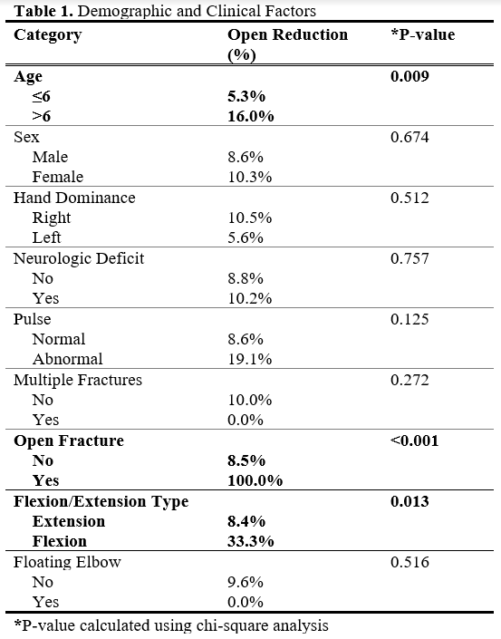
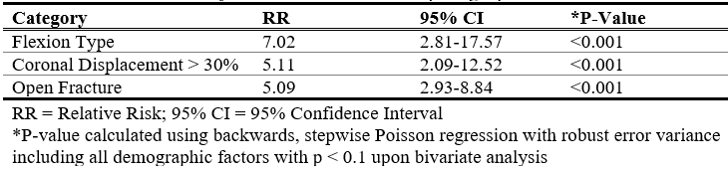
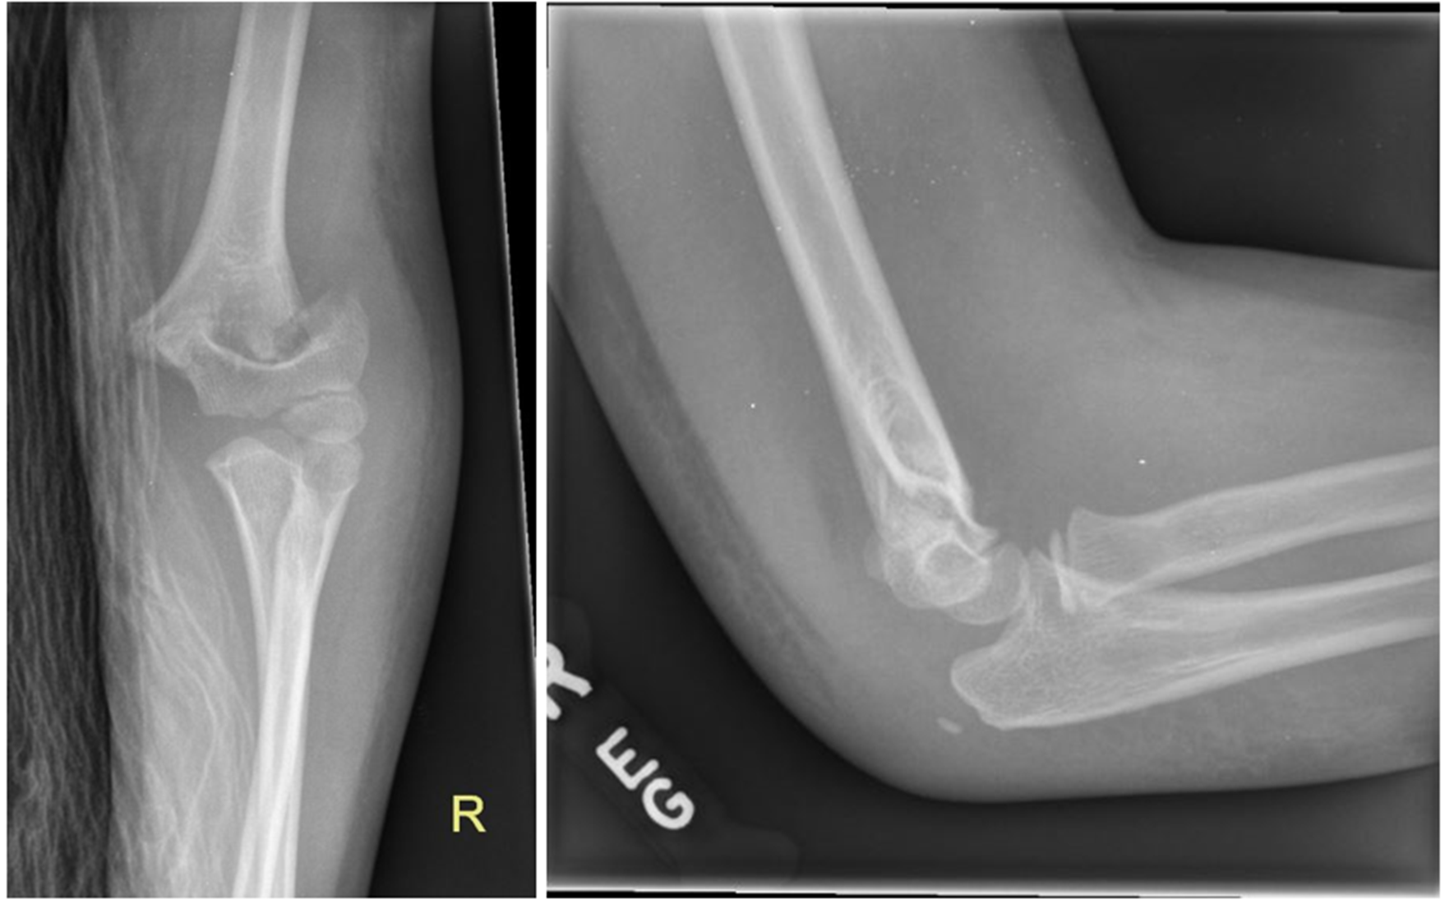
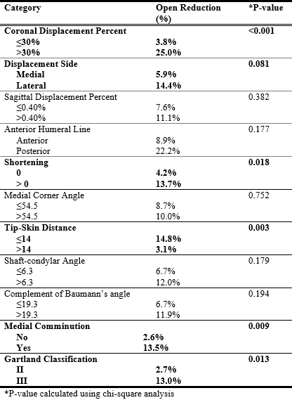
Preoperative Predictors for Open Reduction of Displaced Supracondylar Humerus Fractures
Luke David Latario MD¹, Marc G Lubitz MD¹, Ankur Shah Narain MD¹, Eric Swart MD², Errol Steven Mortimer MD¹
¹ Department of Orthopedic Surgery, UMass Memorial Medical Center. Worcester, MA. ²Lahey Medical Center, Burlington, MA.
BACKGROUND
Table 1: Patient demographic and clinical factors
Table 3: Multivariate analysis of risk factors for requiring open reduction
Supracondylar humerus fractures are a common pediatric orthopedic injury
Many displaced fractures can be closed reduced and percutaneously pinned, some require open reduction
Complications include vascular compromise, neuropraxia, malunion, and compartment syndrome
Most pediatric upper extremity trauma is managed by surgeons without pediatric fellowship training
Preoperative predictors for open reduction can better risk stratify patients and inform decisions for transfer of care to tertiary care facilities
MATERIALS & METHODS
IRB approved retrospective review
Single level 1 trauma center
January 1st 2014- December 31st 2019
Age 2-13
Bivariate analysis using chi-square analysis
Final multivariate model
    Backwards, stepwise regression process
    Included all potential predictor variables with a bivariate p ≤ 0.1 and sequentially excluded variables with highest p-values until only those reaching significance remained
Figure 1: Example AP and lateral x-rays of fracture with minimal sagittal plane deformity and significant coronal deformity requiring open reduction
Table 2: Patient radiographic factors
CONCLUSIONS
RESULTS
Patients with open fracture, flexion type and coronal plane displacement have higher risk of open reduction
These fractures may be considered for transfer for management by surgeons experienced with open reduction of pediatric elbow fractures
195 patients underwent closed reduction percutaneous pinning
  20 required open reduction
  3 open fractures
Bivariate analysis
  Age greater than 6
  Flexion type
  Open fracture
  Coronal displacement >30%
  Lateral displacement
  shortening
  Tip-skin distance less than 14 mm
  Medial comminution
  Type 3 Gartland
Multivariate analysis
  Flexion type
  Coronal displacement
  Open fracture
Disclosures
Authors have no financial conflicts of interest to disclose

